Slide 1




Slide 2
Personal Finance Overview
March 27, 2020
Unbridled Companies with Unbridled Wealth
Effective strategies for budgeting and cutting expenses

Slide 3





YOUR PRESENTERS
Kurt Goss
Julie Mustard
Jonathan Wield
Unbridled Companies
Unbridled Companies
Unbridled Wealth

Slide 4


TODAY’S TOPICS
1
2
3
Basics of Budgeting
Reducing Expenses
Creating a Plan
If you don’t know how to create a budget, you are not alone! Fortunately, Kurt Goss is equipped to help you build a basic budget.
There are so many ways that you can reduce expenses in your daily life. Julie Mustard will give some practical ways to begin this process.
Turn your current problem into an opportunity. Jonathan Wield will give you a couple of principles and practicals for recession proofing your plan.

Slide 5
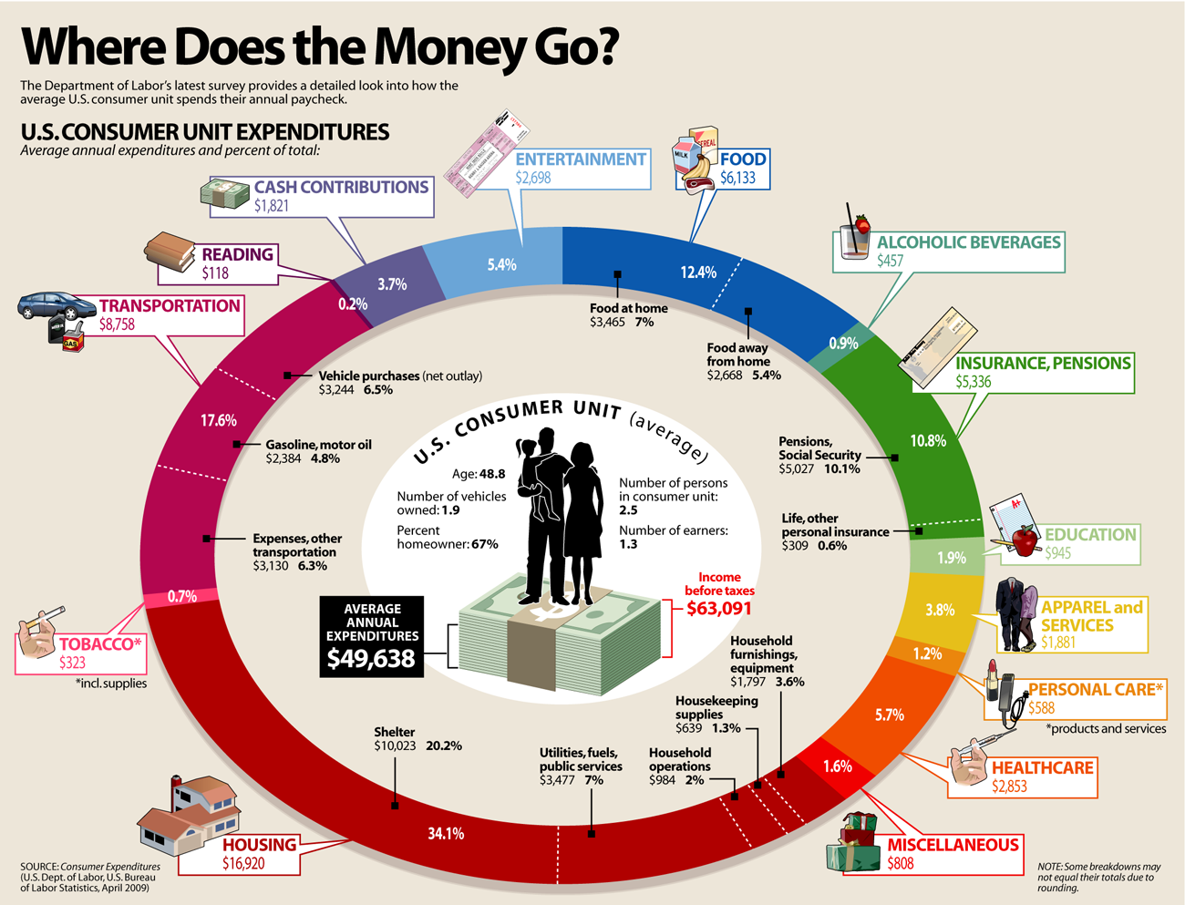

Slide 6

CHROMETOPHOBIA

Slide 7
A Conversation About Money…
-
Letter to the Author of a Finance Book
-
Common words used to describe money
“Frick it, I guess I’ll write the email…
Money stresses me out. My parents didn’t teach me anything about it and I’m very dependent right now. I did a year of nonprofit and made about 20k after taxes and it was miserable, so I figured if I can pull that off for one year then I can make it work. And I did! But I don’t know how to do more than survive (it’s a bit depressing and a big source of anxiety)
Anxious
Scared
Stressed
Overwhelmed
Confusing
It’s Too Late to Learn
The answer is 6-10 depending on how you quantify it. This guy didn’t even notice his reflexive negativity with money. The “lens” through which he views money is bent toward fear.
-
We make day-to-day decisions about money that are often driven by invisible scripts inspired by fear:
Fear that we will never have enough
Fear that we can’t make more of it.
Fear that someone will judge us for our spending or even what we want to spend it on.
-
Author’s Response:
“Good stuff. Great to meet you…
Now I want you to look at your email and count the number of times you use negative words to describe your life/money. How many do you count?”

Slide 8


Slide 9


Slide 10


Slide 11

1
BASICS OF BUDGETING

Slide 12


Slide 13
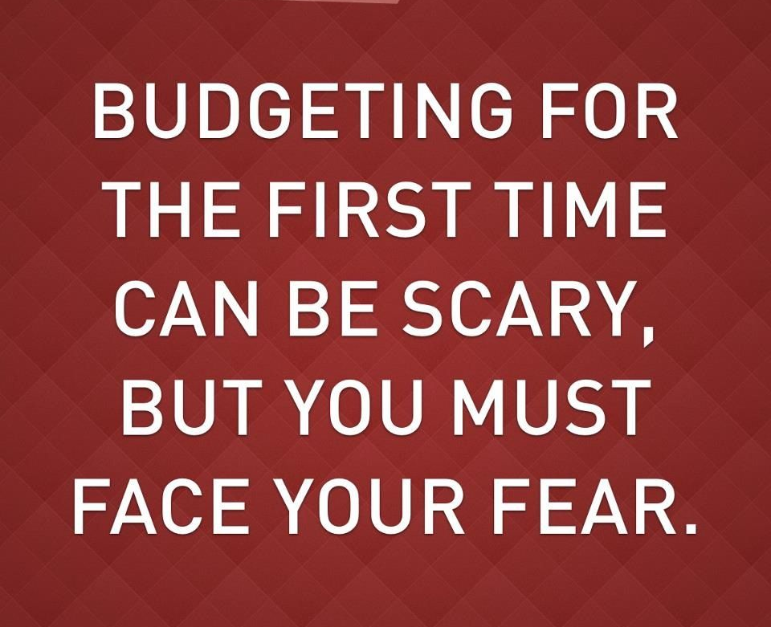
Budgeting is the first step in creating healthy personal finances.
What you don’t know WILL hurt you.
The scary thing is ignoring a problem that could be fixed now to then cause ruin later.
Treat your personal finances as you would treat a project or a business.
Need to understand current state of finances before making financial decisions.

Slide 14
BUDGETS 101
What is a Budget?
What should a budget look like?
A budget is a form that tracks income and expenses over a set amount of time. This is a part of a series of documents each individual should track (Balance Sheet, Budget, & Cash Flow).
A budget should be measurable (actual vs. estimate), done periodically in specific increments, and something that works for you individually.

Slide 15
BAD BUDGET
GOOD BUDGET

Slide 16
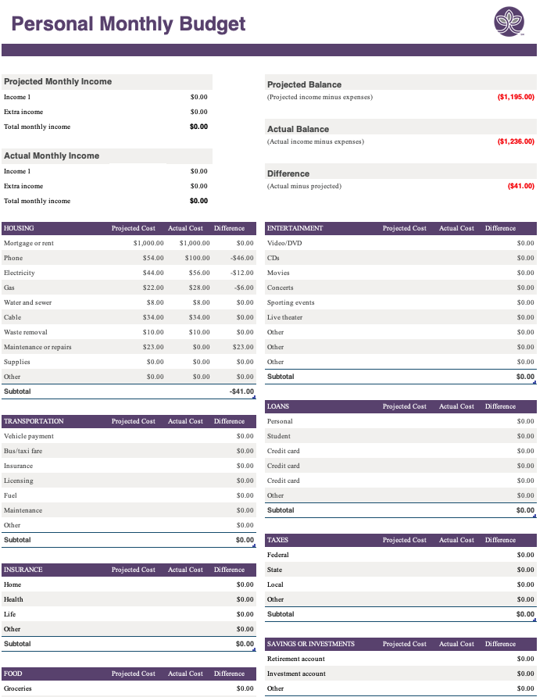
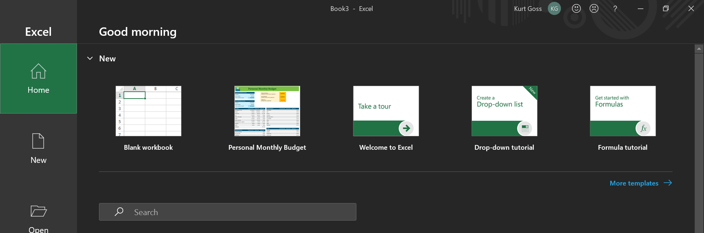
WHERE TO START
EXCEL TEMPLATE
START FROM SCRATCH
If you like to use pen or paper, grab a notebook or print out a budget template.

Slide 17
GATHERING DOCUMENTS
INCOME
EXPENSES
Paystubs
Investment Accounts
Venmo/CashApp/PayPal Statements
Bank Statements
Credit Card Statements
Receipts
Cash Envelopes
Bank Statements

Slide 18
POPULATE YOUR BUDGET
SUGGESTIONS
Stick to monthly, this is the best way to start off.
Start with actual, then move into projections.
Pay yourself first! Invest into savings and retirement accounts first when budgeting.
Think about averages. Ex. Car insurance payment comes every six month at $600/payment. Budget $100 each month to prepare for expense.
Budget with an end goal in mind.
Contact me! Kgoss@unbridled.com (Kurt Goss)

Slide 19
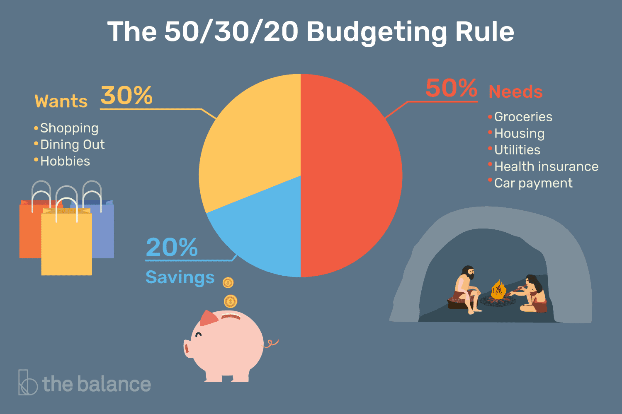

Slide 20
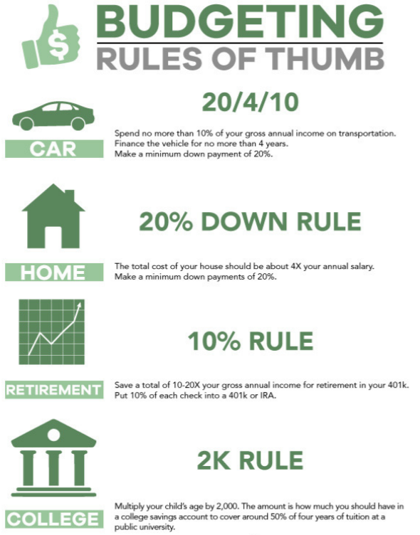

Slide 21
MAKING BUDGETING A BREEZE
SUGGESTIONS
Use one, central bank account and/or credit card.
Understand your expenses and categorize them.
  Pull a credit card statement or bank statement and highlight expenses in green (needs), yellow (lifestyle/comfort), orange (nice but can do without or find alternative), and red (luxuries/first cuts).
  Know ALL automatic deductions.
  Know the timing of your expenses to manage cash flow more efficiently.
Pay for all expenses with a credit card depending on your spending habits.
Group like accounts together.
Fully understand current state of personal finances and know where cuts need to be made to meet financial goals.

Slide 22

2
REDUCING EXPENSES
Now that you know what you spend money on, you can begin reducing your expenses intentionally and purposefully.

Slide 23
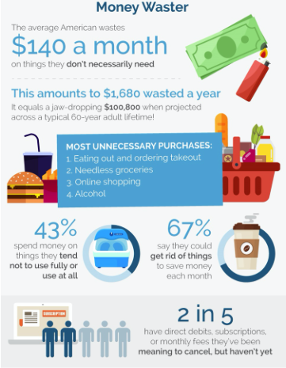
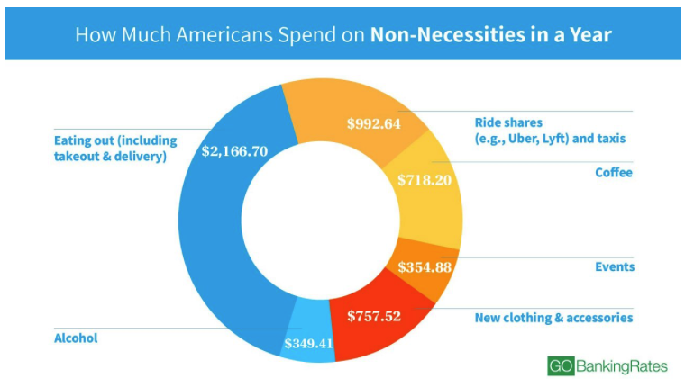

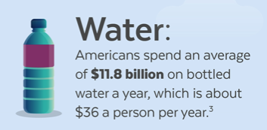


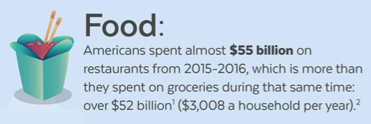

NON-ESSENTIAL SPENDING

Slide 24
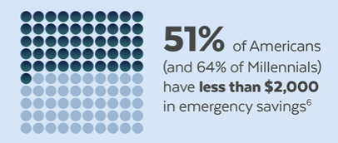

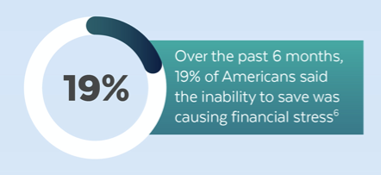

WHAT IS THE RESULT?
THE FEDERAL RESERVE WARNS THAT 4 IN 10 AMERICANS COULD NOT COVER A $400 EMERGENCY WITHOUT GOING INTO DEBT.

Slide 25
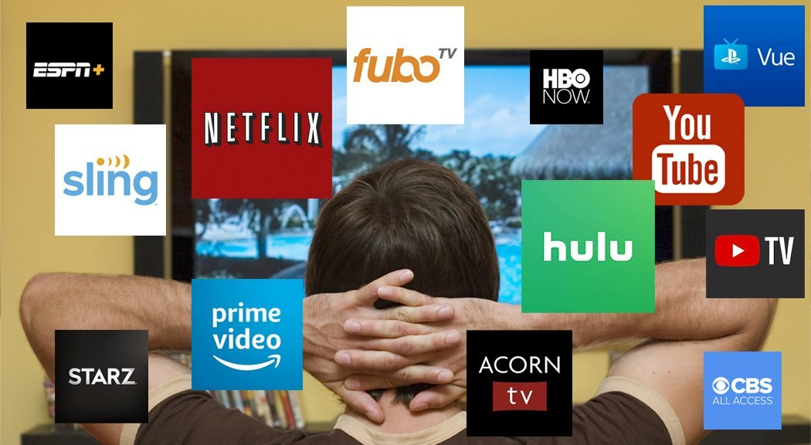
DIGITAL SUBSCRIPTIONS

Slide 26
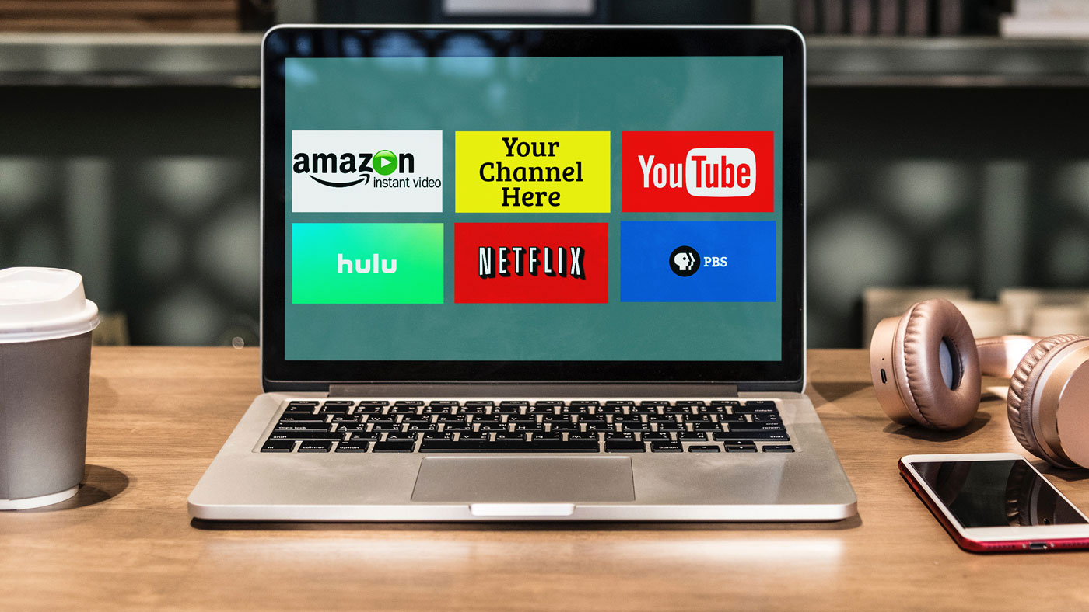
84% of people underestimate what they spend on digital subscriptions
The average American spends $237.33/MO on subscriptions
1 out of 10 millennials spend $200+ a month on digital subscriptions
Wasting Money on Subscriptions
When asked why they did not cancel unused or underused subscriptions, 70% of those surveyed replied:
I FORGOT!!!!

Slide 27

OOPS!

Slide 28
CASE STUDY- NATHAN (Subscription cost per month)
CURRENT SUBSCRIPTIONS
Crossfit- $150.00
Amazon Prime- $12.00
Shave Club- $5.00
Door Dash- $25.00
Apple Music- $9.99
Cable- $49.99
Netflix- $12.99
Hulu- $11.99
Disney+- $6.99
Grocery Delivery- $12.00
Xbox Live- $10.00
BarkBox- $29.00
Audible- $14.99
RomWod- $19.99
TOTAL : $369.93
TOTAL: $347.94
-6%
TOTAL: $326.94
-10%
TOTAL: $247.95
-30%
TOTAL: $177.97
-50%

Slide 29
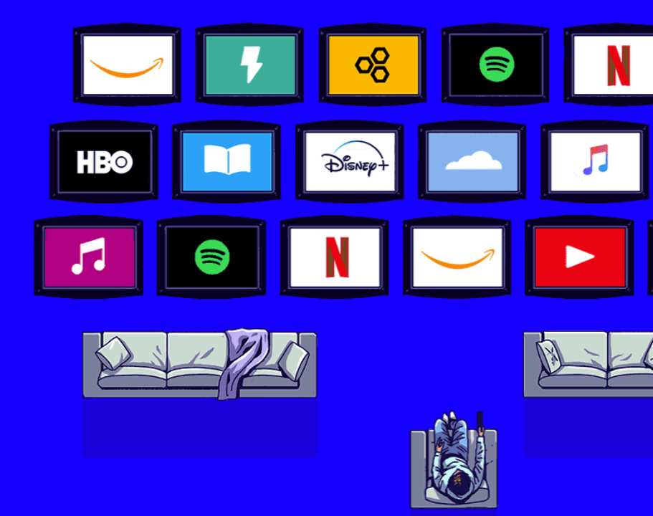
If Nathan decides that he really wants to cut back, his best plan of action is to change his gym from Crossfit to Planet Fitness, get on a family plan for Apple Music, share his Amazon and all streaming accounts. There are ways to be creative and legally share things at the same time. It is reasonable that Nathan could be spending less than $25.00 on monthly subscriptions.
I guess the question is: “What is the dollar amount you want to put on convenience?

Slide 30
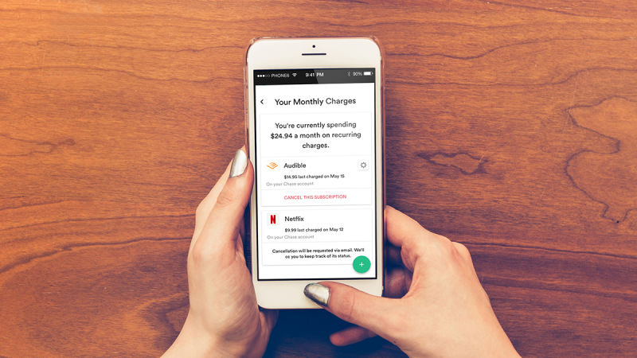
OTHER HELPFUL APPS
TRUEBILL
PAYOFF
UNENROLL.ME
BILLTRACKER
YOU BANK’S APP
DEBTMINDER
LEVELMONEY
BEST BUDGETING APPS
MINT: Overall
PocketGuard: Keep From Overspending
You Need a Budget: Type-A Personalities
Wally: Best for Just Budgeting
Mvelopes: Cash Style Budgeting

Slide 31

How I saved $1,100 a year by changing how I drink coffee…

Slide 32
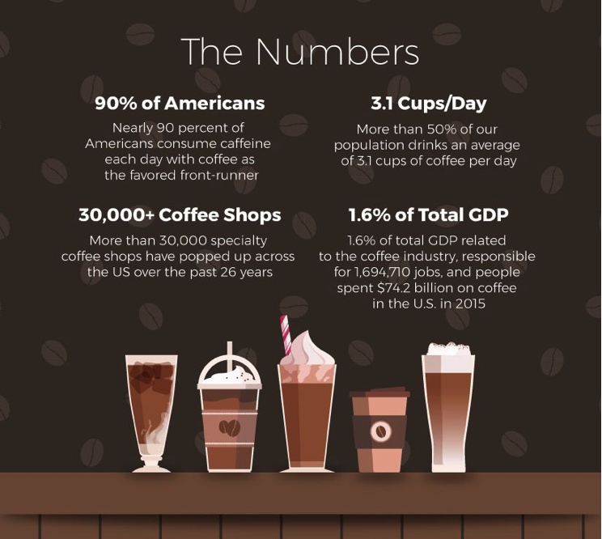
AMERICANS DRINK A LOT OF COFFEE!

Slide 33
COFFEE AND SUBSCRIPTIONS
175.00/MO
104.33/MO
60.42/MO
$8.66/MO

Slide 34
$104/MO
$60.42/MO
$45.00/MO

Slide 35
OTHER WAYS TO CUT EXPENSES
• Be grateful for what you do have.
• Look at automatic draws and credit card charges and cancel non-necessity memberships
• Call Mortgage company to see if payment can be deferred or reduced
• Call credit card company to see if payments can be deferred or reduced
◦ Request a rate reduction
• Use credit to purchase and pay off full statement balance upon due date
• Consolidate your student loans or place into deferment if available
• Buy products in bulk where available
◦ Buy generic instead of name brands
• Cook at home instead of eating out
• Xcel Energy is allowing for assistance with utility bills. Call Xcel to request assistance
• Unplug electrical items not in use
• Lower the temp on the hot water heater
• Unemployment????
• Special grants for bartenders experiencing cash shortage
• Bundle home and auto insurance
• Stop buying so many clothes!
• Make gifts for people, instead of buying
• Buy less expensive cleaning products
• Simplify your "beauty" routine
• Turn lights off more and replace bulbs with high-efficiency ones
• Raise your insurance deductibles
• Lower your cell phone bill
• Reduce or eliminate consumable habits (smoking, alcohol consumption)
• For those facing a financial strain, the Supplemental Nutrition Assistance Program (SNAP), could be extremely helpful. It provides a cash benefit for food to help supplement those expenses.

Slide 36
3
PLANNING FOR RETIREMENT
RECCESSION PROOFING YOUR PLAN

Slide 37

There are three types of people.
THE
DEBTOR
THE
SAVER
THE
WEALTH
CREATOR
THE
WEALTH
CREATOR
Utilizes uninterrupted compounding interest. Money making money.

Slide 38
There are three lands.
NOT
ENOUGH
JUST
ENOUGH
MORE THAN
ENOUGH
Creating from an income baseline.
Everyone starts at a specified income baseline.

Slide 39
THE
DEBTOR
THE
SAVER
THE
WEALTH
CREATOR
The average American spends:
5 hours researching a car purchase
5+ hours researching a vacation
10 hours brushing their teeth each year
124 hours researching a house purchase
250 hours planning a wedding
335 hours doing hair & makeup each year
876 hours on social media each year
THE
DEBTOR
No savings. Earns no interest. Pays interest. Borrows from lenders at highest market rates. Loses future earning potential as collateral.
Retirement Planning…
…90% of people said less than 5 hours per year

Slide 40
THE
DEBTOR
THE
SAVER
THE
WEALTH
CREATOR
THE
When asked why people don’t plan for retirement:
I’M TOO BUSY…
IT’S TOO SOON…
IT’S TOO LATE…
I DON’T HAVE ENOUGH MONEY…
I HAVE A 401(k)…
DEBTOR
No savings. Earns no interest. Pays interest. Borrows from lenders at highest market rates. Loses future earning potential as collateral.
I DON’T KNOW HOW!

Slide 41
The Problem and The Opportunity…
MORE THAN
ENOUGH
The Scenario
Sally, a 25 year old earning $40,000 has been living paycheck to paycheck and doesn’t have a budget or a retirement plan. She feels too embarrassed to ask for help. Sally finds out she is getting a 6% paycut .
The Strategy
Sally leans into the unknown and learns how to build a budget
She manages to reduce her expenses by 6%
6 months later, her pay is restored to $40,000
She takes the 6% and puts it in an account earning 5%
She continues contributing 6% each year until she retires
At age 65, she would have an additional $500k…
The
WEALTH
CREATOR

Slide 42
Retirement Planning Questions
JUST
ENOUGH
Should I open a 401(k)?
What is the average return in a 401(k)?
Is deferring my tax a good thing?
What can I invest in?
How much access do I have?
How much should I be funding it?
Should I make extra payments on my mortgage?
Very limited access: Pro or Con?
You pay less in interest: Pro or Con?
THE
SAVER
Save 6 Months of Expenses
Accessible cash: Pro or Con?
Low interest rate, but guaranteed: Pro or Con?

Slide 43



COMMON KNOWLEDGE
UNCOMMON KNOWLEDGE
Uninterrupted compounding
Lost Opportunity Cost

Slide 44
THE
DEBTOR
THE
SAVER
THE
WEALTH
CREATOR
THE
The Power of Uninterrupted Compounding
SAVER
Uninterrupted Compounding…
You have $1 and it doubles every year for 20 years. How much money do you have?
Year 5: $16
Year 10: $512
Year 20: $524,288
Interrupted Compounding…
You have $100. It earns 50% the first year and loses 50% the second year. How much money do you have?
Year 1: $100 + 50% = $150
Year 2: $150 / 2 = $75
Saves and earns interest. Pays cash. Borrows from self, reducing current collateral position and interrupting compound gains.

Slide 45

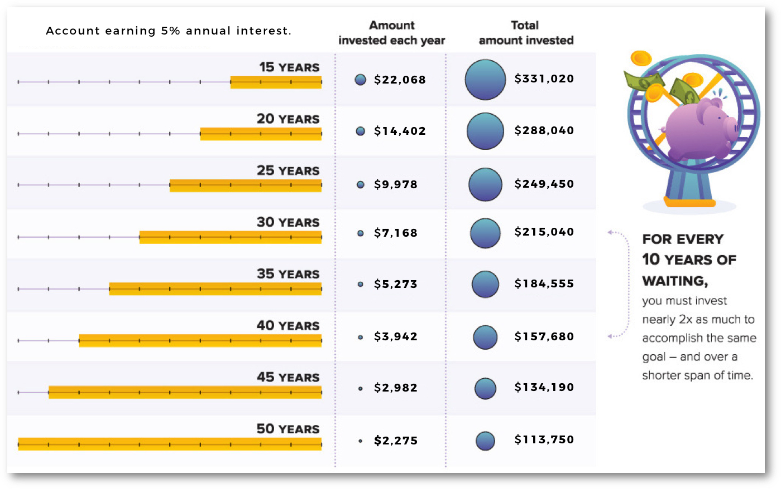
UNINTERRUPTED COMPOUNDING
TOTAL VALUE - $500,000
51%
74%
100%
133%
171%
217%
273%
340%

Slide 46
THE
DEBTOR
THE
SAVER
THE
WEALTH
CREATOR
What is Lost Opportunity Cost?
“The benefit foregone by choosing another course of action.”
Example.
You loan someone $100,000 for a year at 5% interest. 6 months later a $200,000 house forecloses and is being sold for $100,000. You can’t buy it because you don’t have the cash.
THE
WEALTH
CREATOR
Utilizes uninterrupted compounding interest. Money making money.

Slide 47
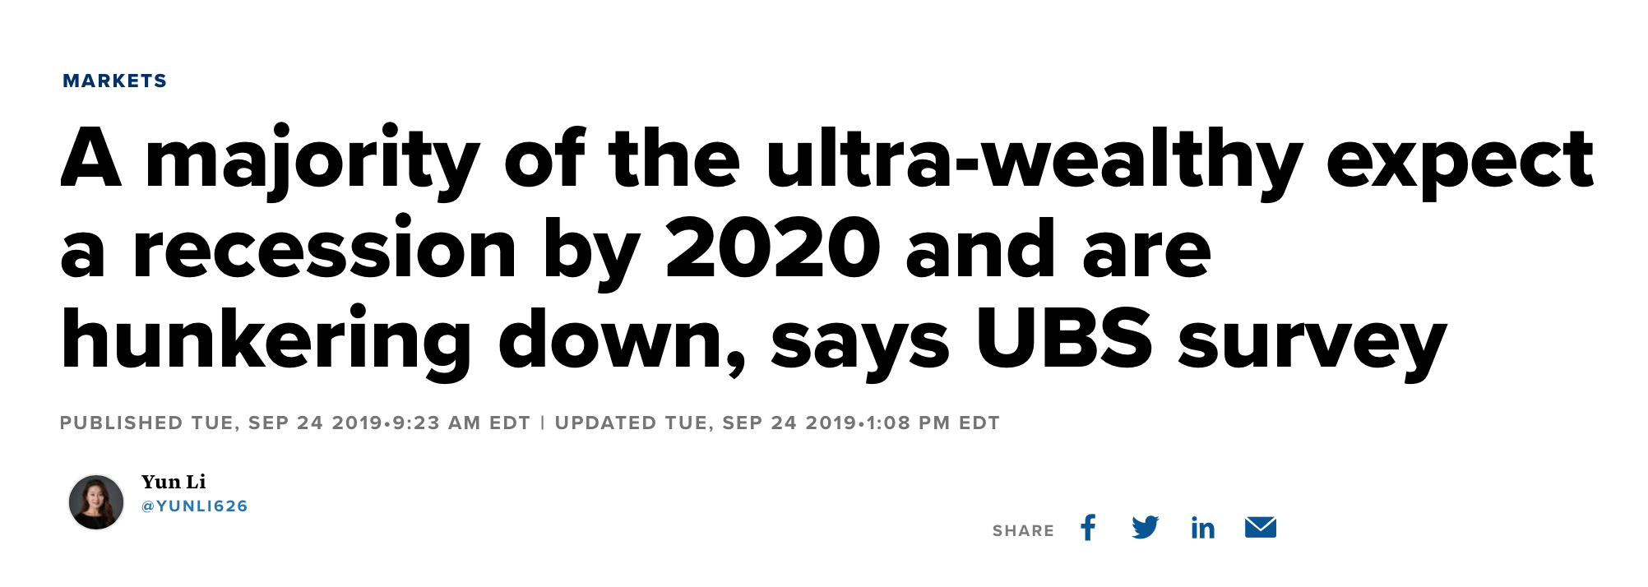
THE
DEBTOR
THE
SAVER
THE
WEALTH
CREATOR
THE
WEALTH
CREATOR
Utilizes uninterrupted compounding interest. Money making money.

Slide 50

YOU CAN DO THIS!

