Slide 1

Planning Pod Training

Slide 2
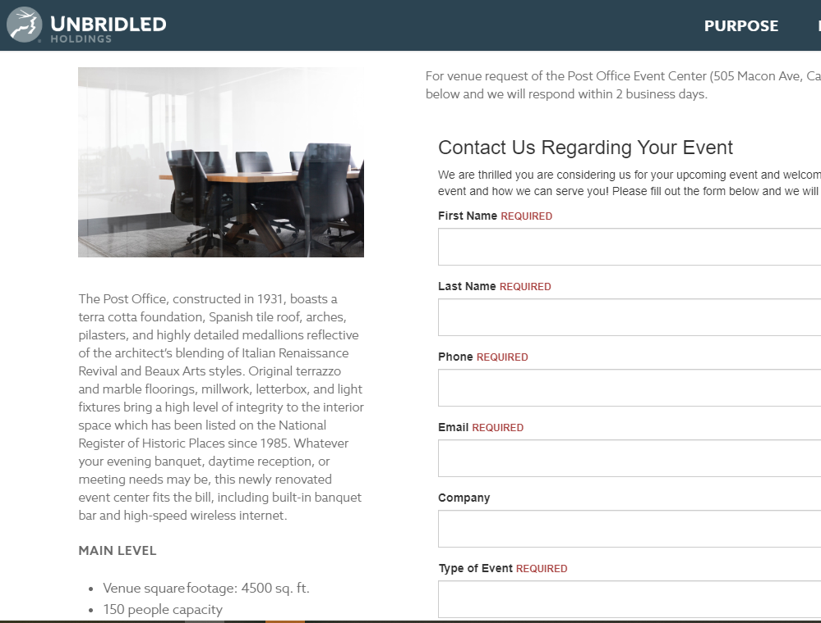
Lead Retrieval
You were notified with an email saying there was a new lead submitted from the Unbridled Holdings site.
https://unbridledholdings.com/
Hanna entered a new lead manually from a voicemail left.
or
All calls that come in through 8X8 account are transcribed into Planning Pod as a new lead.
Current access has been given to Hanna and Margo

Slide 3
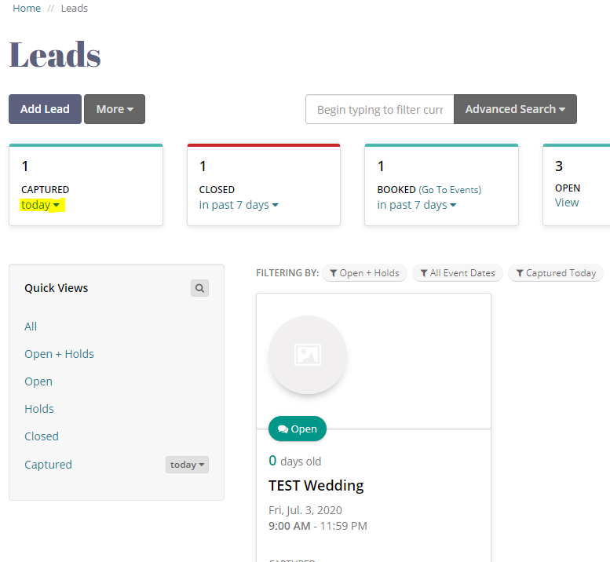
Lead Retrieval
Now that you have a lead, what’s next?
It’s time to call the client to verify the lead and determine next steps!
The phone number will be in the contact information of the Lead. Access the lead from the email that was sent to you, OR directly in Planning Pod.
To access, click Leads on the left-hand side.
You can sort leads in the first box by selecting how old the leads are. In the example, we updated to leads from Today, so we could see the most recent leads submitted.
Click the Lead you would like to access. For Instance, the TEST Wedding.

Slide 4
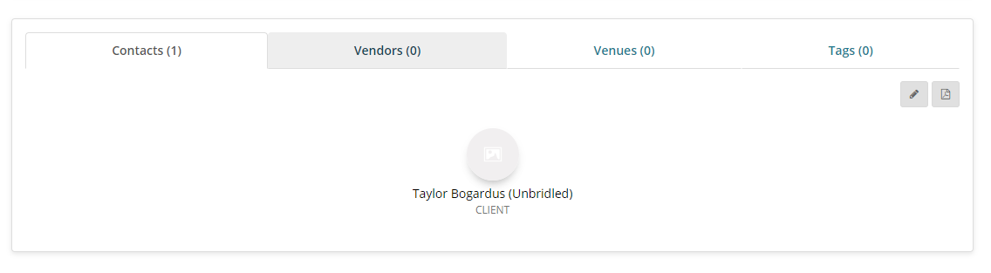
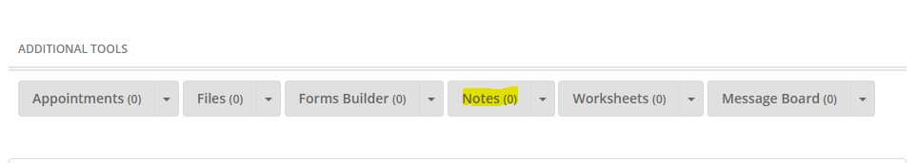
Lead Retrieval
Contact information will be listed at the bottom of the page for the Lead you clicked on. Click into the contact to find the contact information.
While on the phone with the client, take notes in the Note section of the Lead, under the Additional Tools Section of the Lead. Add New Note.

Slide 5
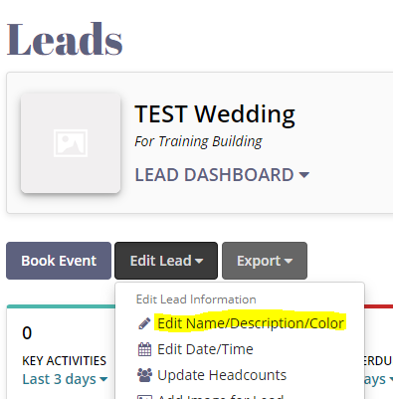
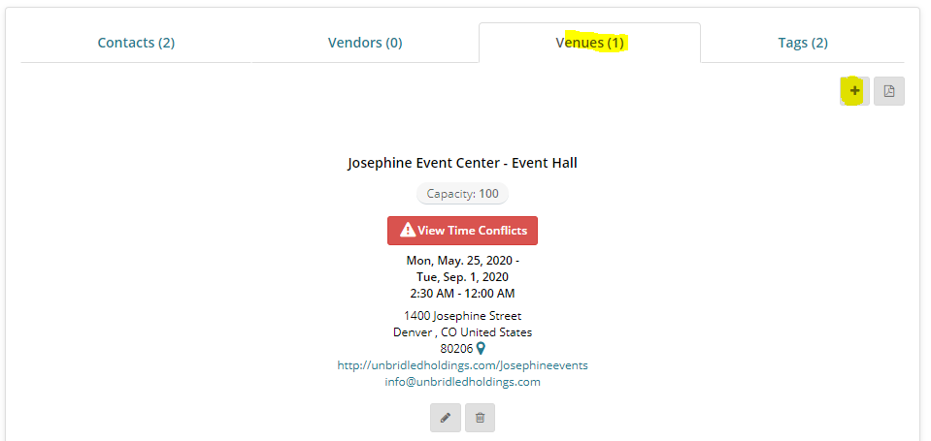
Lead Retrieval
After you chat with the client…
Update the name of the Lead with the name of the event.
Verify the Venue and assign the Venue to the Lead

Slide 6
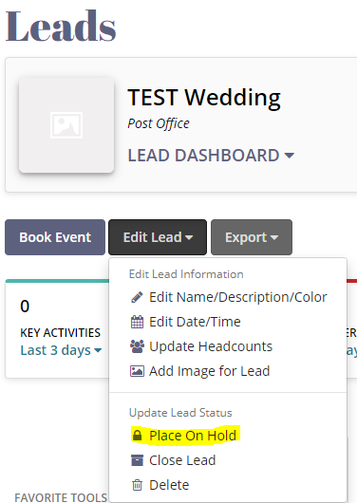
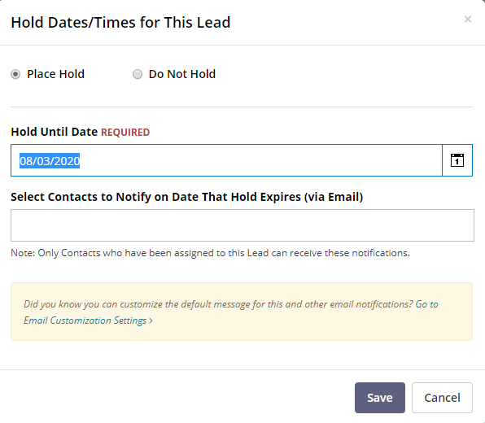
Converting a Lead to a Hold
After your initial call with the potential client, confirming the Lead. Update the Lead to a Lead Hold.
Enter the Hold Until Date as one month after the event date.
Update the Select Contacts to Notify on Date That Hold Expires (via Email) to be Hanna.

Slide 7
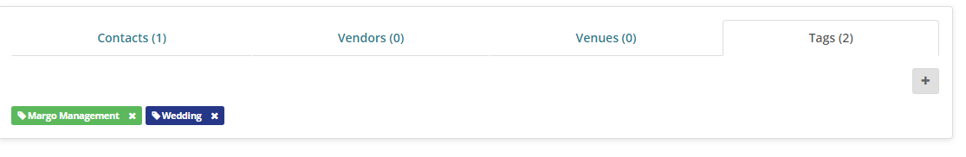
Converting a Lead to a Hold
Now we need to officially assign the event to a planner using Tags
Tags are used for sorting and reporting.
Scroll to the bottom of the page, click Tags, then the plus sign to add tags.
You will add a tag for the Planning Manager, and for the type of event it is, and the event venue.
There is a Tag for UnbridledActs
If there are any additional contacts in the Contact section of the Lead Hold, please delete them out.

Slide 8
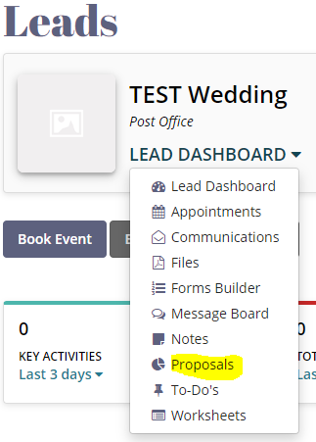
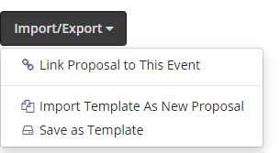
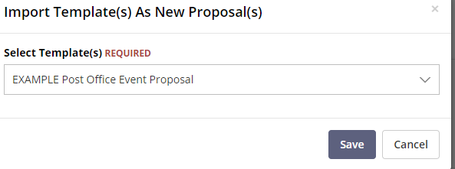
Proposal
Time to send a proposal to the client for review and signature!
Access proposals from the Lead Dashboard Drop Down
Select Import/Export and Import Template as New Proposal
Choose the template for the venue of the event.

Slide 9
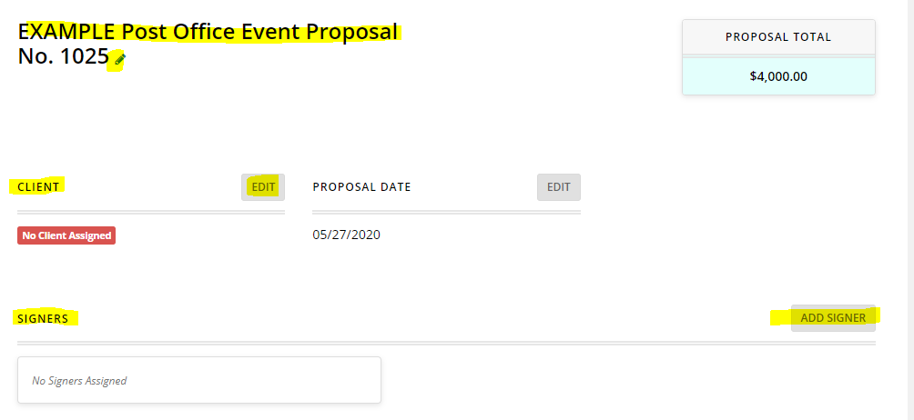
Proposal
Update the title to “Client Name_Event Type_Venue_Proposal” by clicking the pencil. Leave the number as is.
Edit the client to add the client contact
Add signers to the Proposal. Signers should be the Client and one person from Unbridled Holdings as a counter-signature.

Slide 10
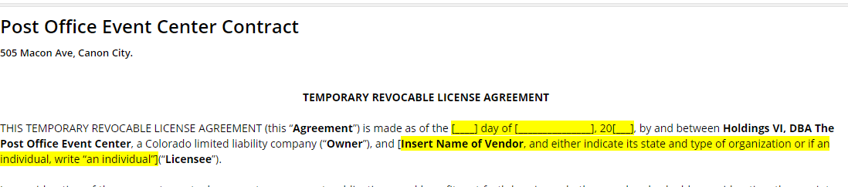
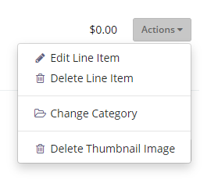
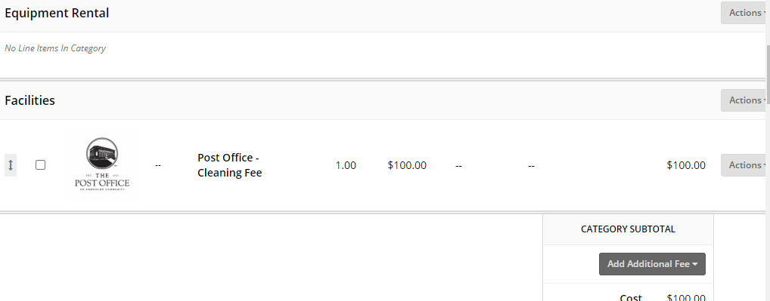
Proposal
Update all parts of the terms highlighted in yellow
Scroll through the proposal line items and edit line items that are needed with the quantity and price; remove what is not.
Click Actions on the right-hand side to edit the line items or delete.

Slide 11
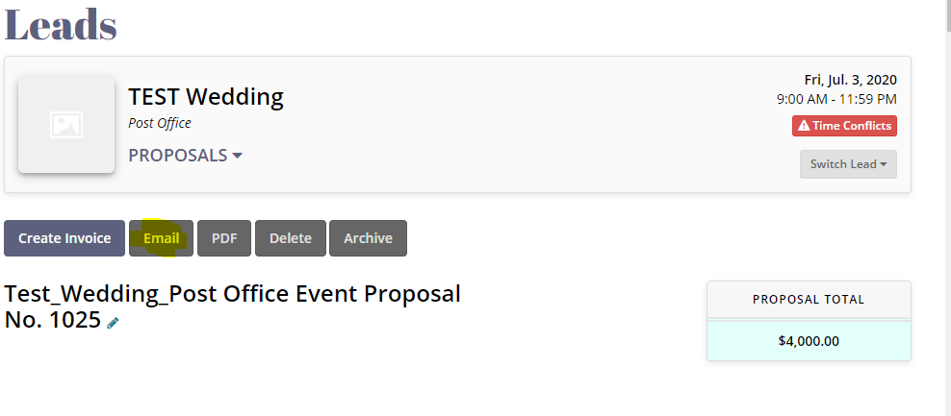
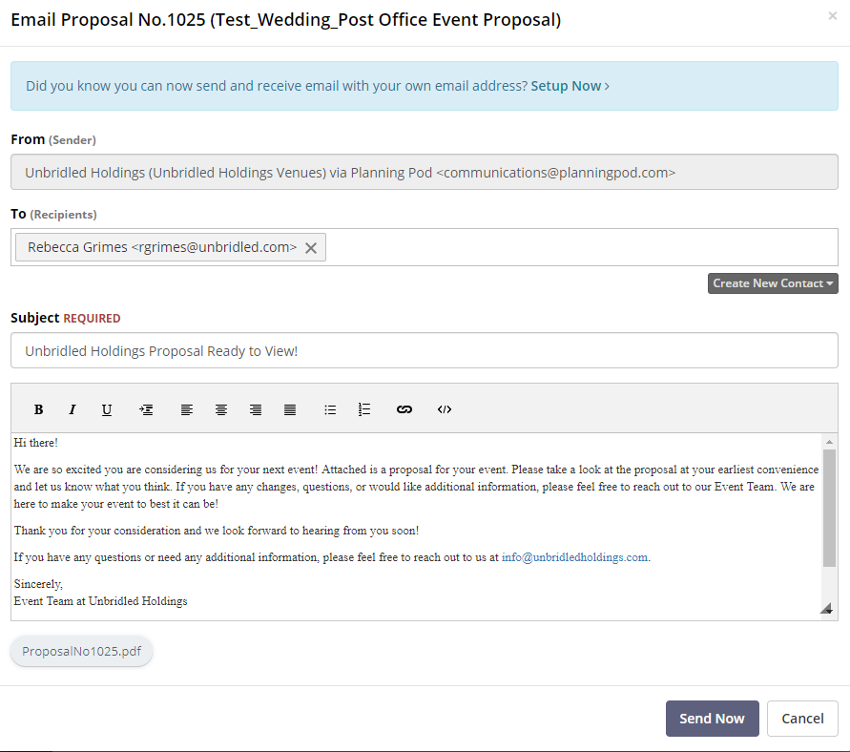
Proposal
Time to send to the client!
At the top of the proposal, select “Email”
Edit the email subject and body to personalize your message to the client then click Send Now

Slide 12
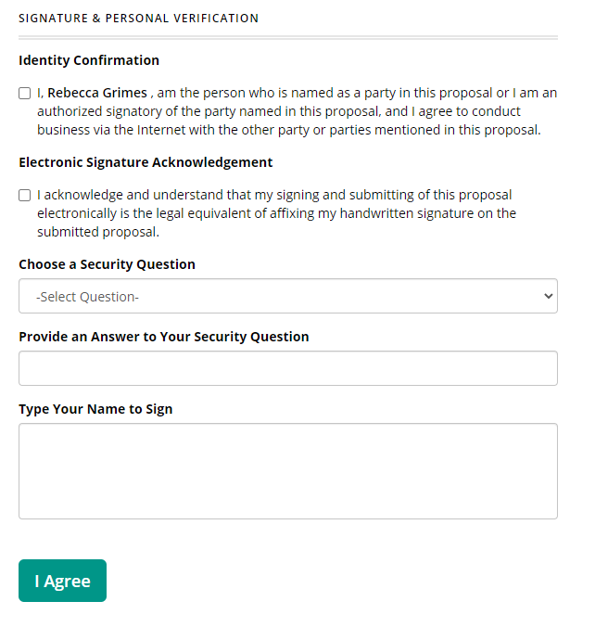
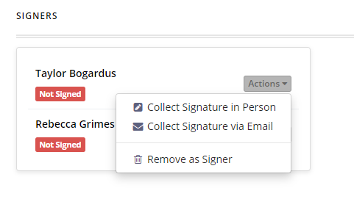
Proposal
Once the proposal is final and agreed upon, collect the signatures.
You can send a request for signature via email or collect the signature in person. If requested via email a notification will be sent to the client. If collected in person, a new browser will open and the client will type to sign on the spot. Both are the same online signing process.
Once the client has signed, the Unbridled Holdings representative can counter sign

Slide 13
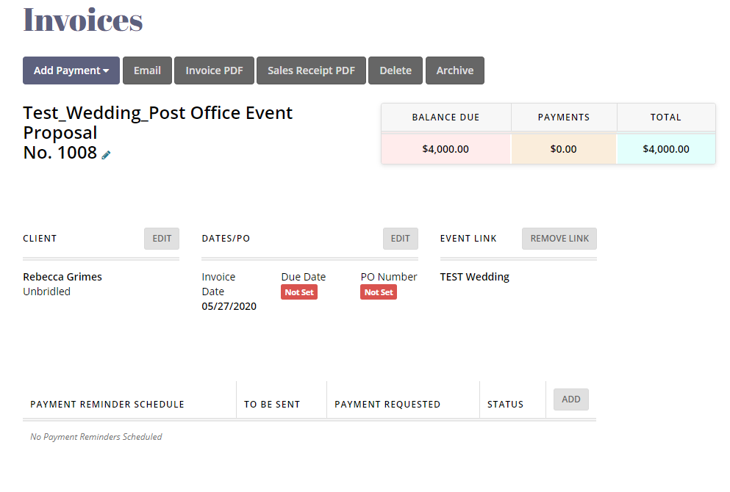
Convert the Lead Hold to a Booked Event
The proposal is signed…now what?
Get that money! Convert the accepted proposal into an invoice by selecting Create Invoice.

Slide 14
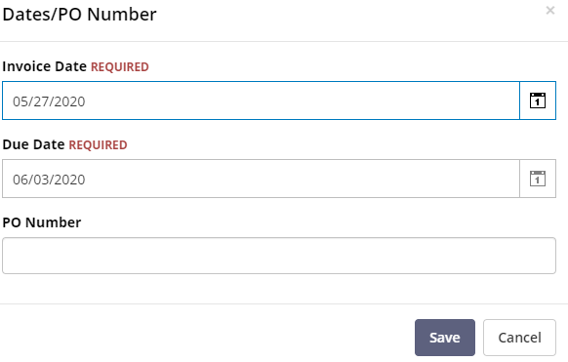
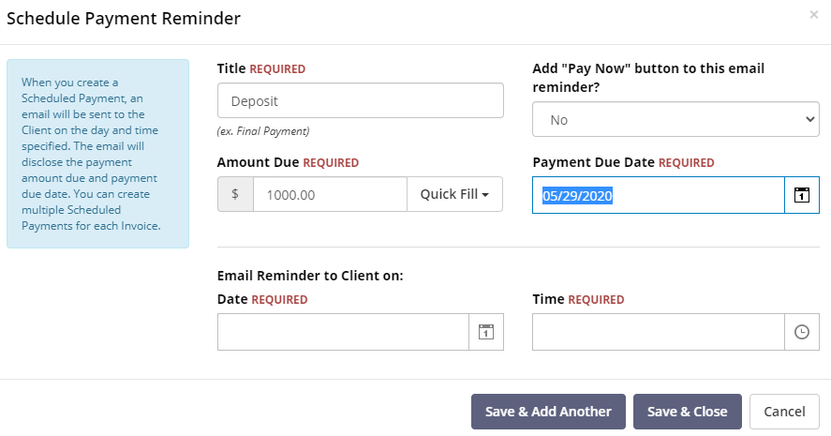
Invoice
Update the Due Date to the date of the final payment.
Set up a payment schedule and reminder for each payment. Use the Quick Fill to calculate the amount due.
Deposit: 25%
2nd Payment: 25%
Final Payment: 50%
Note: Balance Due is the balance of the original invoice, it does NOT adjust when payments are made.
Payment Due Date should be __ days after date sent
Reminder emails should be set to send (1) day prior to the due day at 10:00 AM.

Slide 15
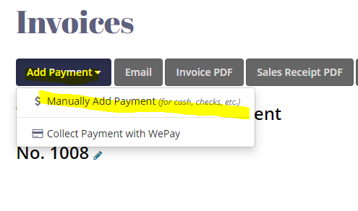
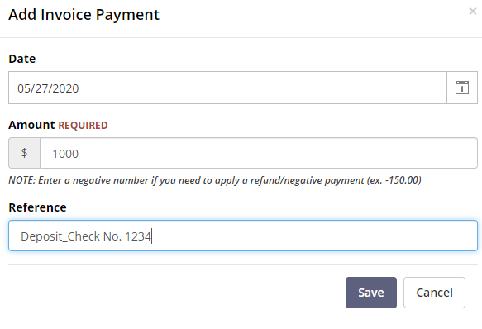
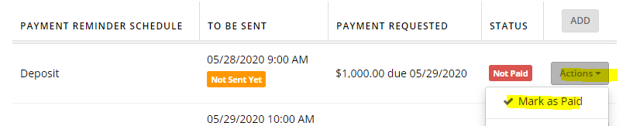
Invoice
Send to the client via email by selecting Email button at the top of the invoice.
As payments come in, selecting Add Payment and select Manually. Enter the Check Number and what payment it was for in the reference, then mark the payment as paid.

Slide 16
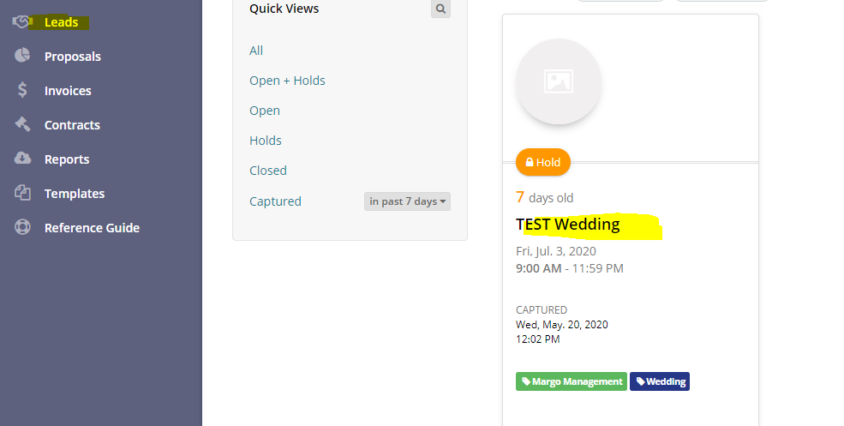
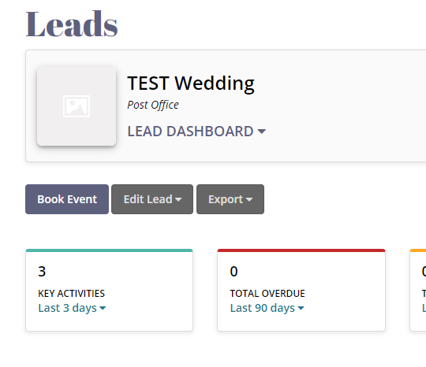
Convert the Lead to a Booked Event
Go back to the Leads from the side menu and click into your lead
Click Book Event

Slide 17
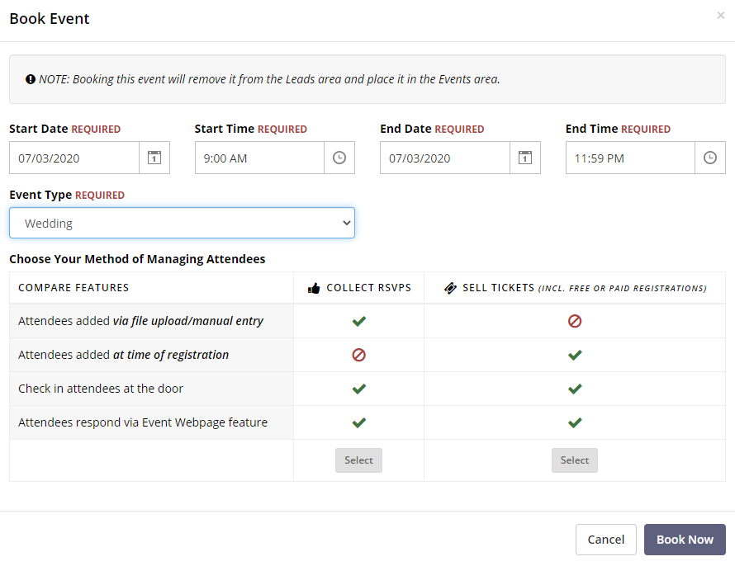
Convert the Lead to a Booked Event
Update the start and end dates and times if they have changed. Adjust the Event Type.
Select Collect RSVPs
Select Book Now.
Email your Venue Manager and On-Site Manager that their venue has been booked.

Slide 18
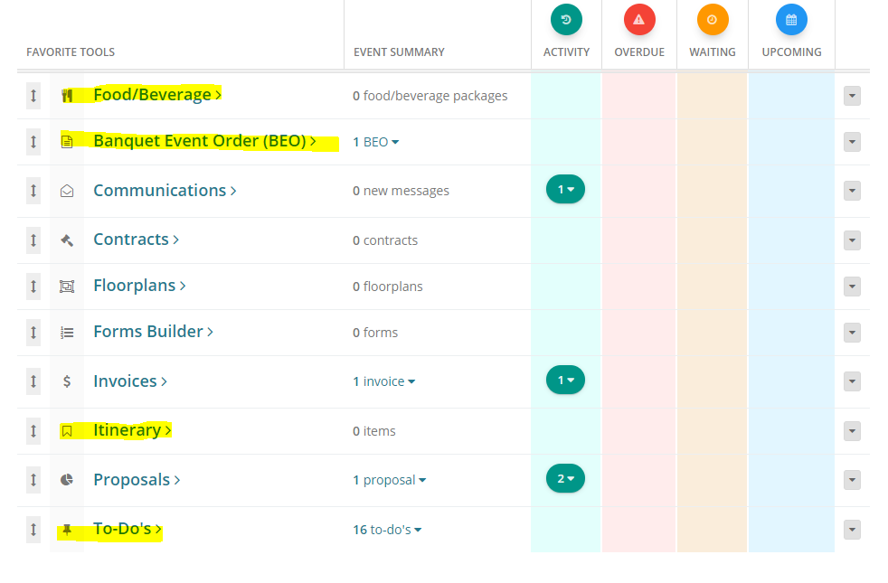
Event Management
Update your Itinerary with the schedule of the event
Add your Food/Beverage
Update your BEO

Slide 19
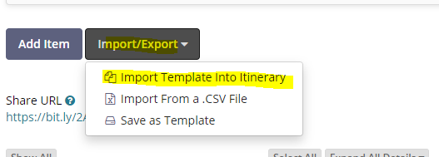
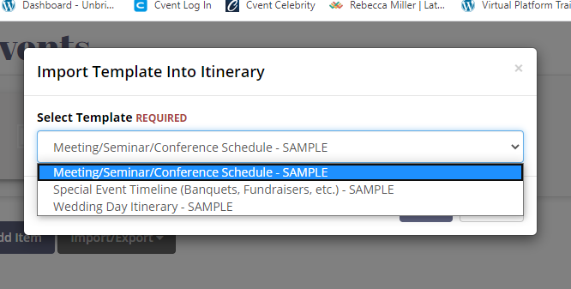
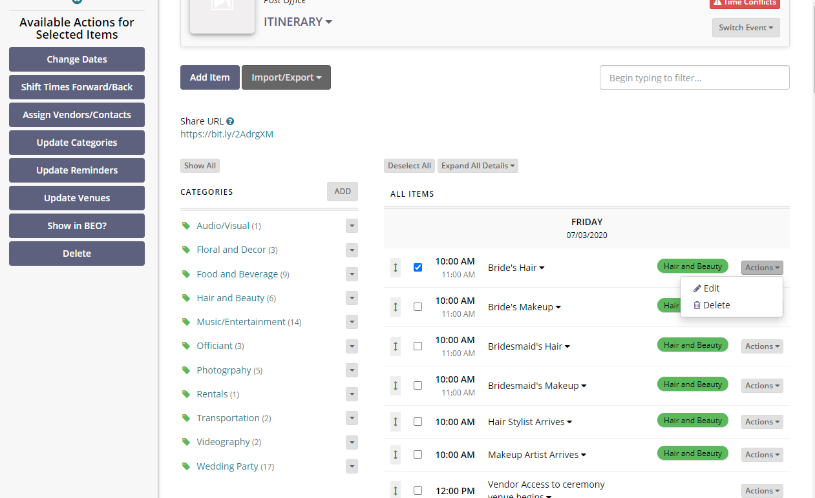
Itinerary
Select Itinerary from the Favorite Tools
Select Import/Export and choose to Import Template as Itinerary
This will open a new box where you can select which template you’d like to add
Adjust to fit your event – you and select multiple items to bulk update (side menu) or Edit/Delete using the Actions dropdown to the right of the item.

Slide 20
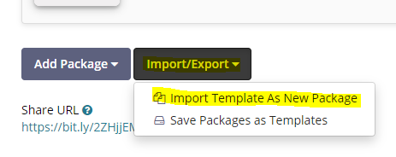
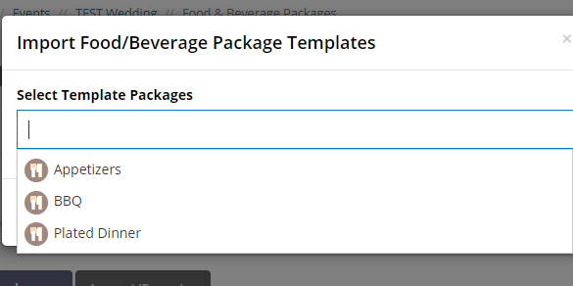
Food and Beverage
Select Food/Beverage from the Favorite Tools.
Select Import/Export and choose to Import Template as New Package.
This will open a new box where you can select as many packages as you’d like to add.

Slide 21
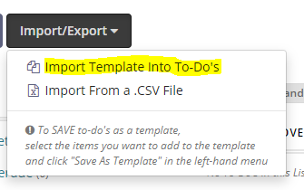
To – Do’s
From the Lead Dashboard, go to the To – Do’s
Import a Template into To – Do’s
Update the To – Do list items based on details you know about the event as a whole. Click Actions to make changes to the To – Do list item.

Slide 22
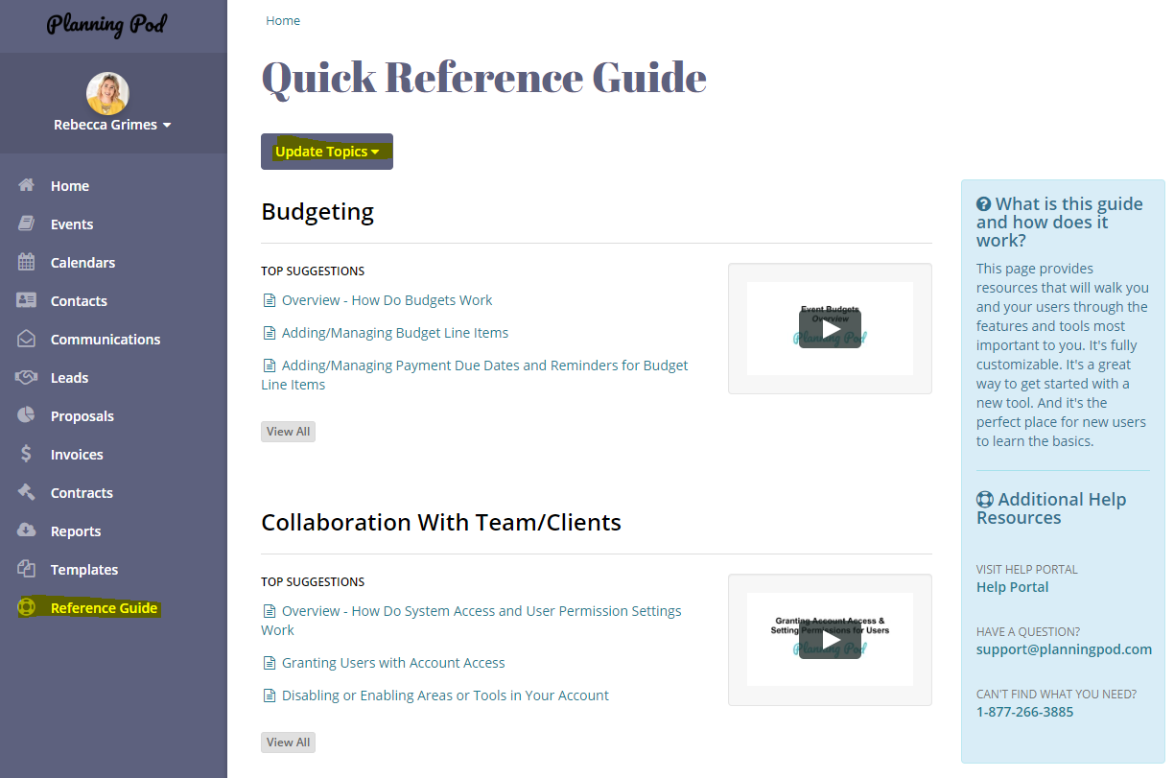
Help Resources
On the left menu you’ll find a Reference Guide that has lots of helpful videos. Use the Update Topics dropdown to narrow your search.
You’ll also find some additional help resources on the left side.
You can also access the chat feature by clicking the Help icon at the bottom right of the screen. If someone is available, they will live chat. If not, a support ticket is issued.
Additionally, access their YouTube channel - https://www.youtube.com/channel/UClLA8mCZksH_FHAkUQ8tSjg

